Slide 1
Volatile Organic Compound Measurements and Ozone Trends in Tucson
Department of Hydrology and Atmospheric Sciences
University of Arizona
Eric Betterton
Eduardo Saez
Kyle Rine
Kisiel Chapman
Ruby O'Brien-Metzger
Richard Pepel
Diana Picon
Acknowledgements
NASA Space Grant Program

Slide 2
Objectives
Determine what has caused Tucson ozone levels to exceed the EPA's NAAQS
Measure ambient VOC concentrations in Tucson for the first time
Whether Tucson is VOC-limited or NOx-limited
Quantify the contribution of biogenic VOCs to ozone production in Tucson

Slide 3
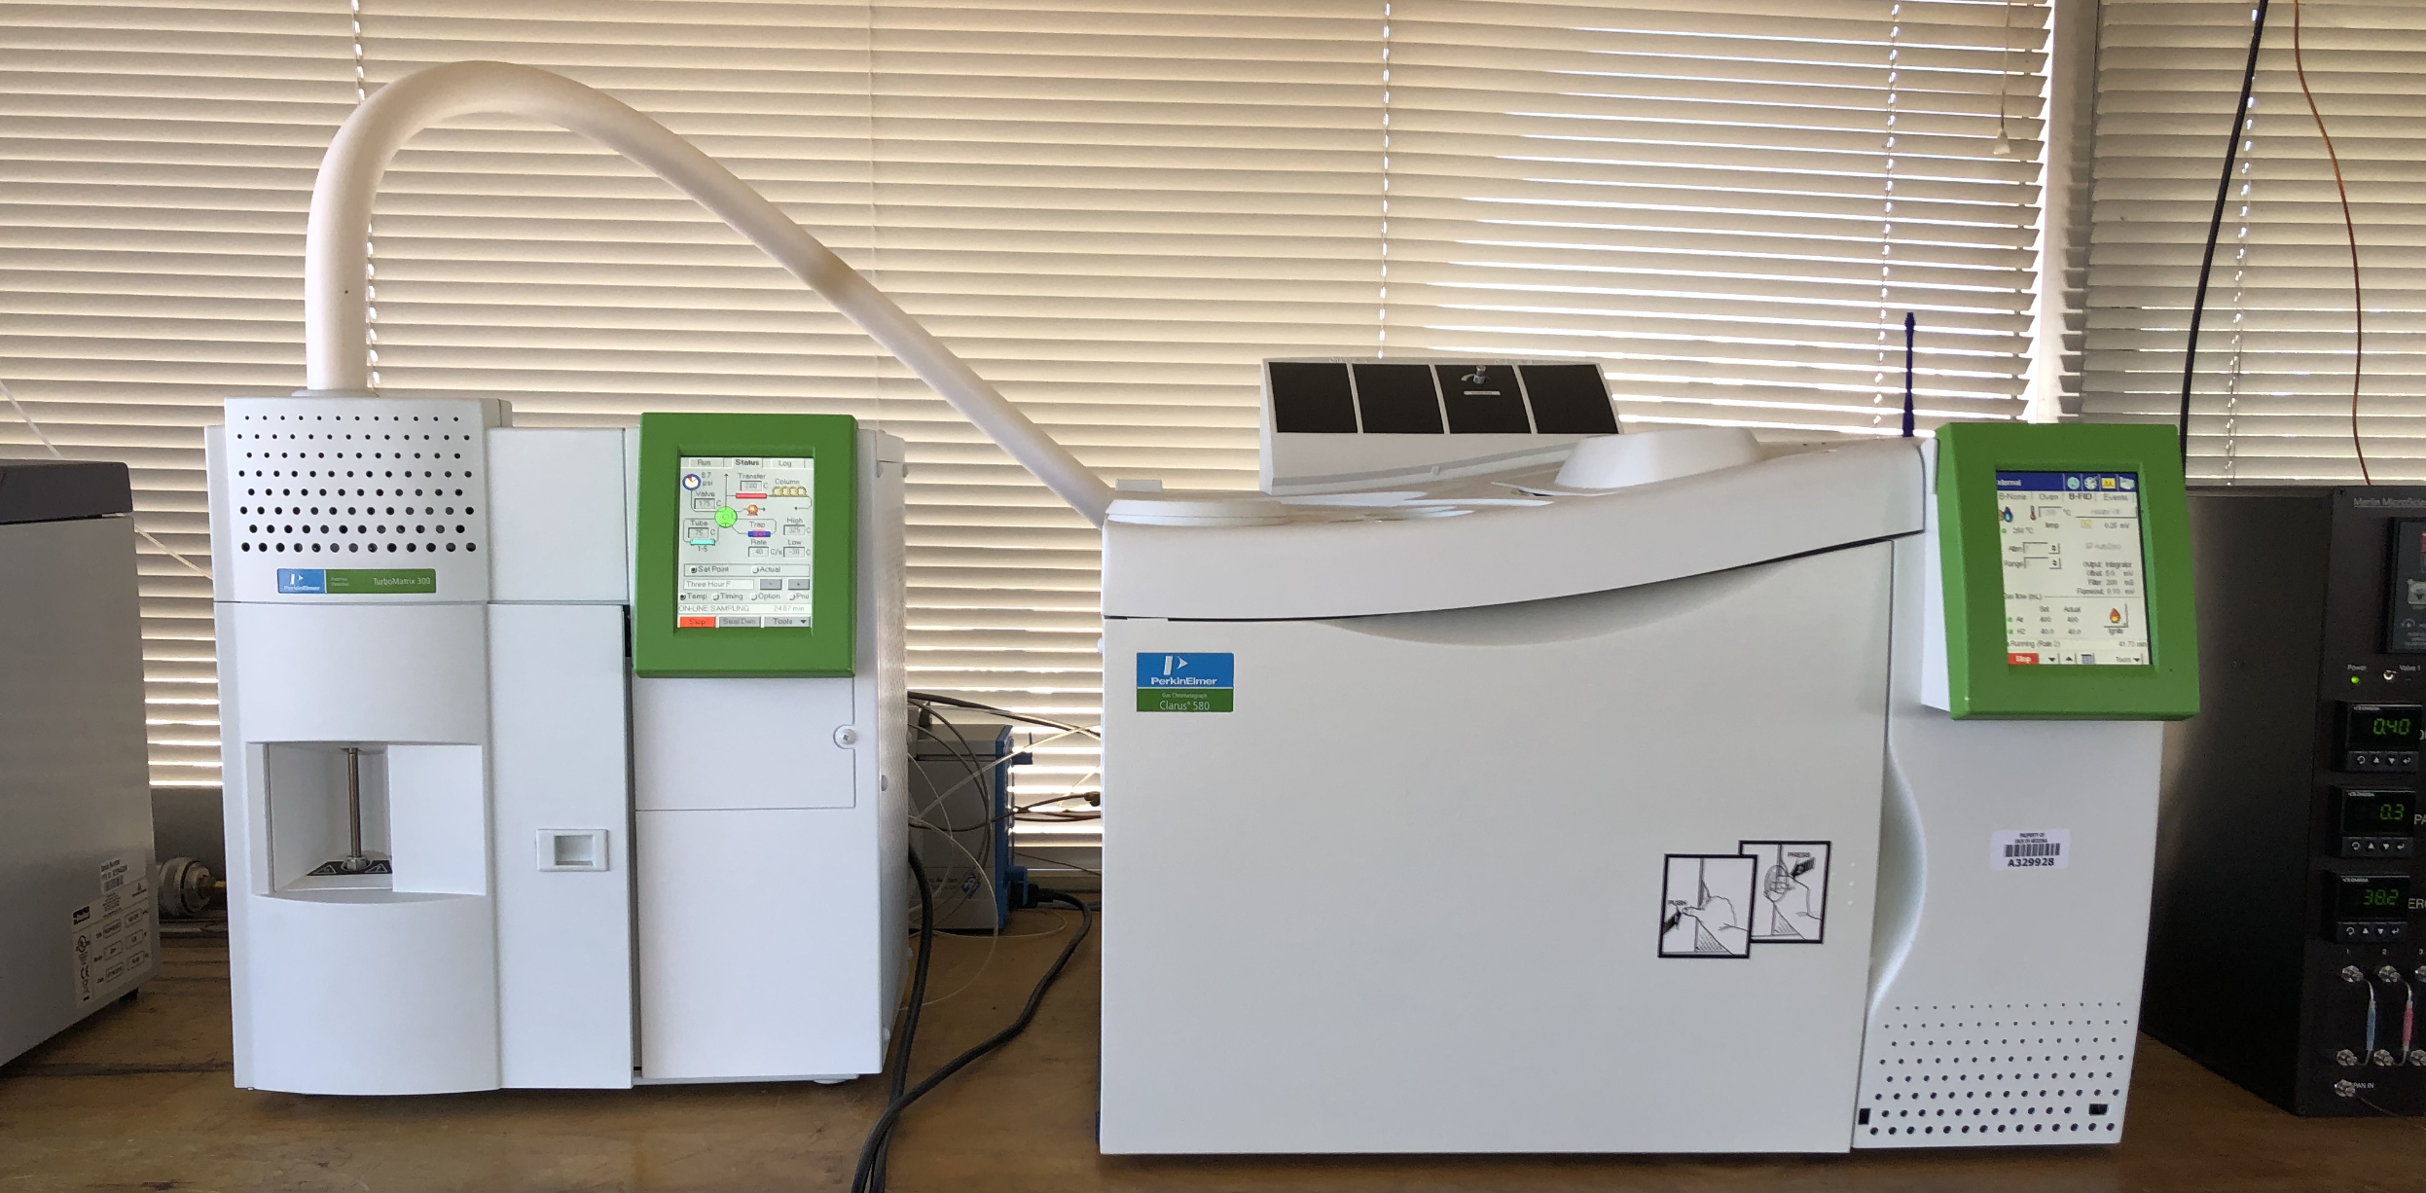
Materials and Methods
Collection and Concentration
Chromotography
Analysis (FID)
Cryotrap, Thermal Desorber and Gas Chromatograph Physics/Atmospheric Sciences Rooftop lab ​

Slide 4
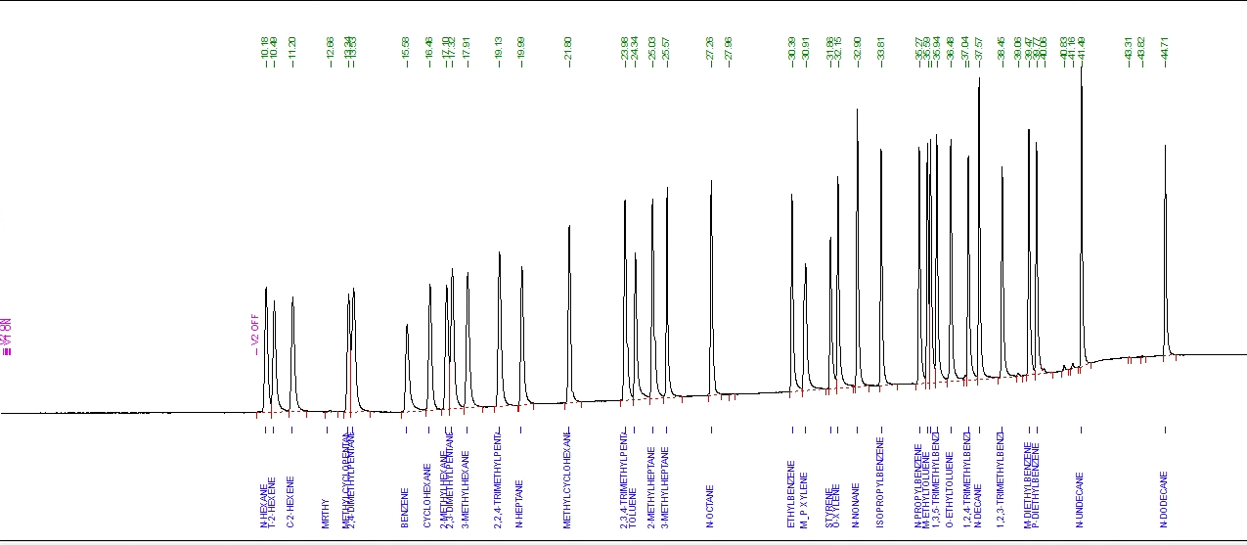
Standard A Column

Slide 5
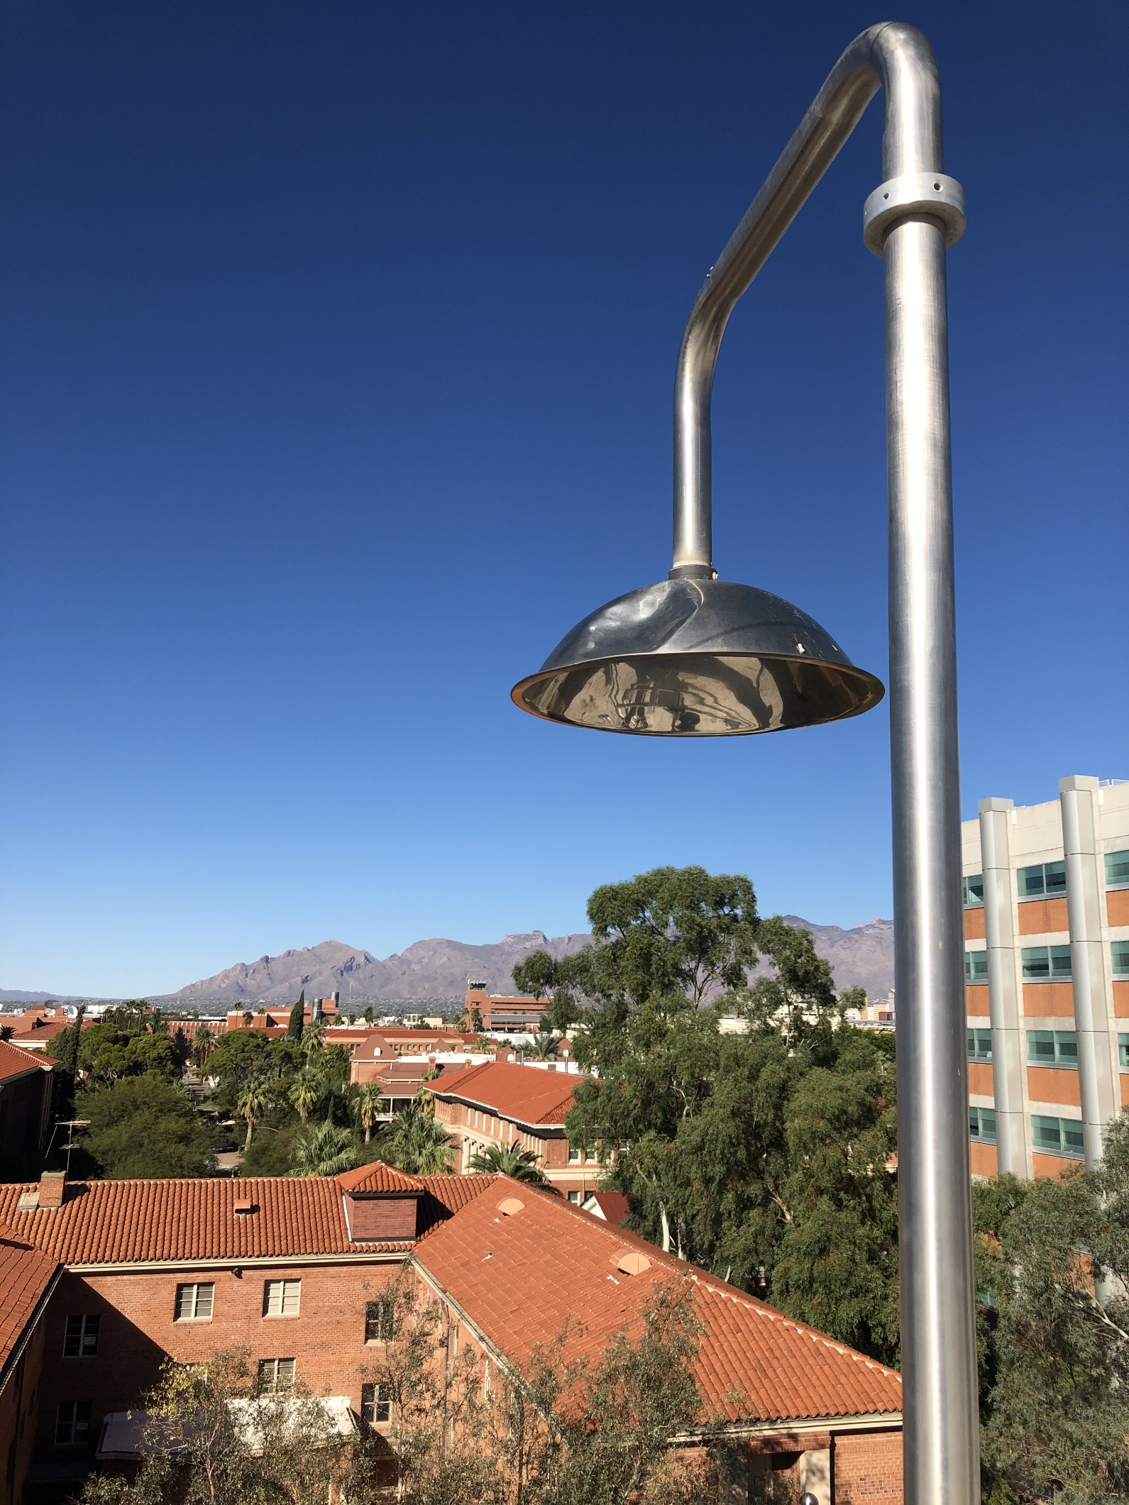
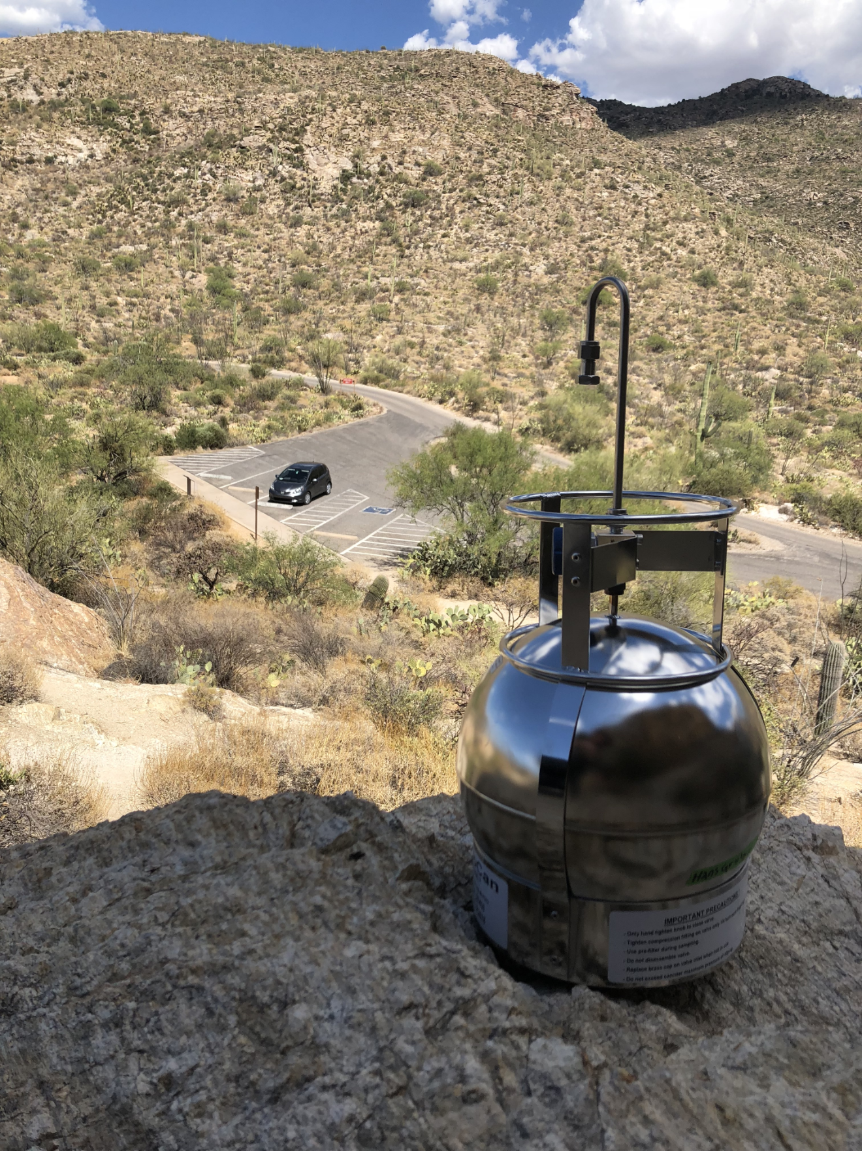
Sample Collection March 2019 to Present
Rooftop
N = 12,000
Suma cannisters
N = 60

Slide 6
Sampling Locations​

Slide 7
Cannister Samples Across Tucson Area
(4 samples) (3 samples) (6 samples) (13 samples)

Slide 8
Downtown Averages at Highest and Lowest Ozone Levels
Tendencies:
High VOC concentration in the morning, low in the afternoon.
Higher NOx concentration in the morning than the afternoon.

Slide 9
Typical Noon Sample at University of Arizona
(All samples taken at noon.)

Slide 10
Anthropogenic vs. Biogenic VOCs

Slide 11
VOC Concentration vs. Ozone Concentration
*
*
* Days ozone level exceeded 70 ppb

Slide 12
NOx Concentration vs. Ozone Concentration
*
*
* Days ozone level exceeded 70 ppb

Slide 13
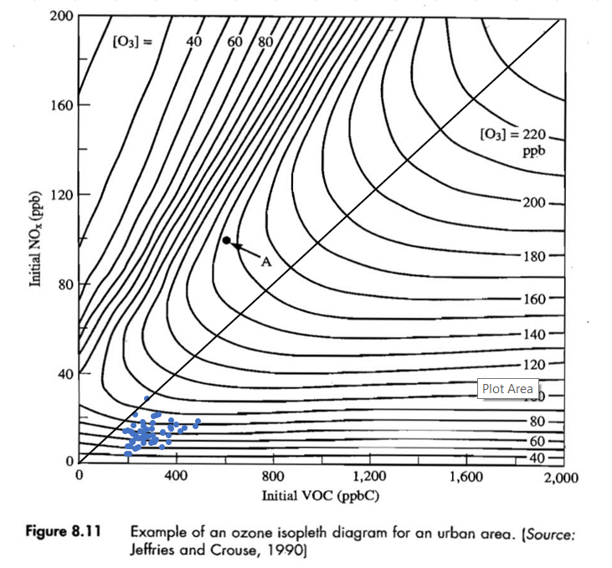
Ozone Isopleth - Tucson
Notes:
Source: Tucson NOx: PDEQ , Phoenix Ozone: Cracking the AQ Code (AZDEQ), Phoenix NOx: Ozone production rate and hydrocarbon reactivity in 5 urban areas: A cause of high ozone concentration in Houston (Kleinman 2005)

Slide 14
Conclusion
First VOC measurements taken in Tucson
Over 12,000 data points collected
Isoprene comprised a relatively small portion of the VOCs measured
High VOC to NOx ratio observed in Tucson

